Slide 1
RELATIONAL ALGEBRA
RELATIONAL ALGEBRA
RELATIONAL ALGEBRA OPERATIONS

Slide 2
Learning Objectives
Define Relational Algebra
Understand relational algebra operations
To specify what is required and what are the procedure / steps to obtain the required output
To define operators that transform one or more input relations to an output relation
How to form queries in relational algebra

Slide 3
RELATIONAL ALGEBRA
Theoretical procedural language with operations that work on one or more relations to define another relation without changing the original relation(s).

Slide 4
RELATIONAL ALGEBRA
Both the operands and the results are relations. So the output from one operation can become the input to another operation.
Allows expressions to be nested, just as in arithmetic. This property is called closure.

Slide 5
RELATIONAL ALGEBRA BASIC OPERATIONS
Selection
Projection
Cartesian Product
Union
Set Difference

Slide 6
RELATIONAL ALGEBRA BASIC OPERATIONS
The other operations which can be expressed in terms of five basic operations are:
Join
Intersection

Slide 7
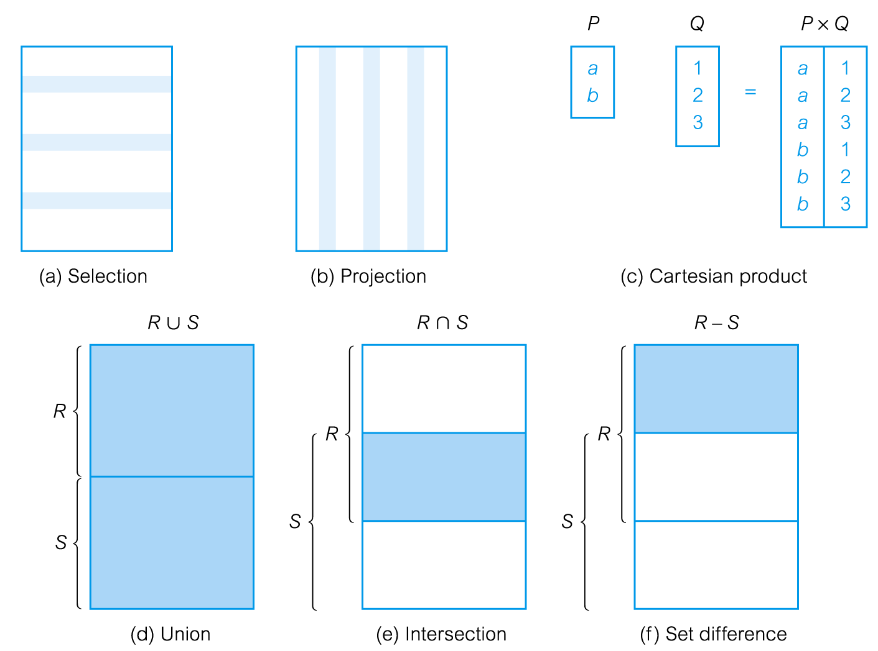
RELATIONAL ALGEBRA OPERATIONS

Slide 8
FIVE BASIC OPERATORS
Unary Operators
Select
Project
Binary Operators
Union
Set Difference
Cartesian Product

Slide 9
SELECT
Works on a single relation R and defines a relation that
contains only those tuples of R that satisfy the specified
predicate.
Select Table_Name Where Predicate [ Giving New Table ]
Symbolic Notation: σ _{Predicate} (RELATION)

Slide 10
SELECT
To define predicates use comparison operators: =, ≠, <, ≤, >, ≥
Logical operators ∧ (AND),∨ (OR) and ~ (NOT) can be used to define more complex predicates.
The Degree of the resulting relation is the same as the degree of the relation

Slide 11
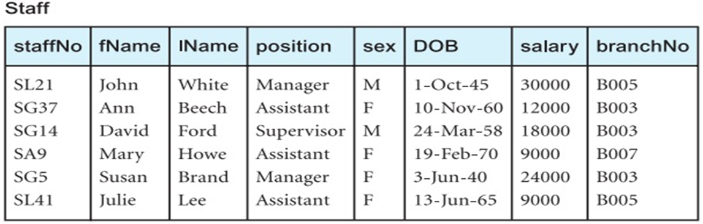
STAFF RELATION

Slide 12
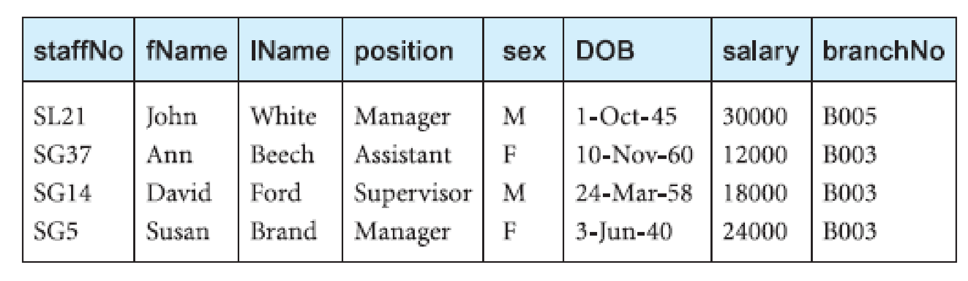
EXAMPLE: SELECT
List all staff with a salary greater than £10,000
σ_{salary > 10000} (Staff)

Slide 13
PROJECT
Unary operator that Works on a single relation R and defines a relation that contains a vertical subset of R, extracting the values of specified attributes and eliminating duplicates.
Symbolic Notation: Π_{a1, a2. . . , ak} (R)
where a₁ ... a_{k} are attribute names and R is a relation name

Slide 14
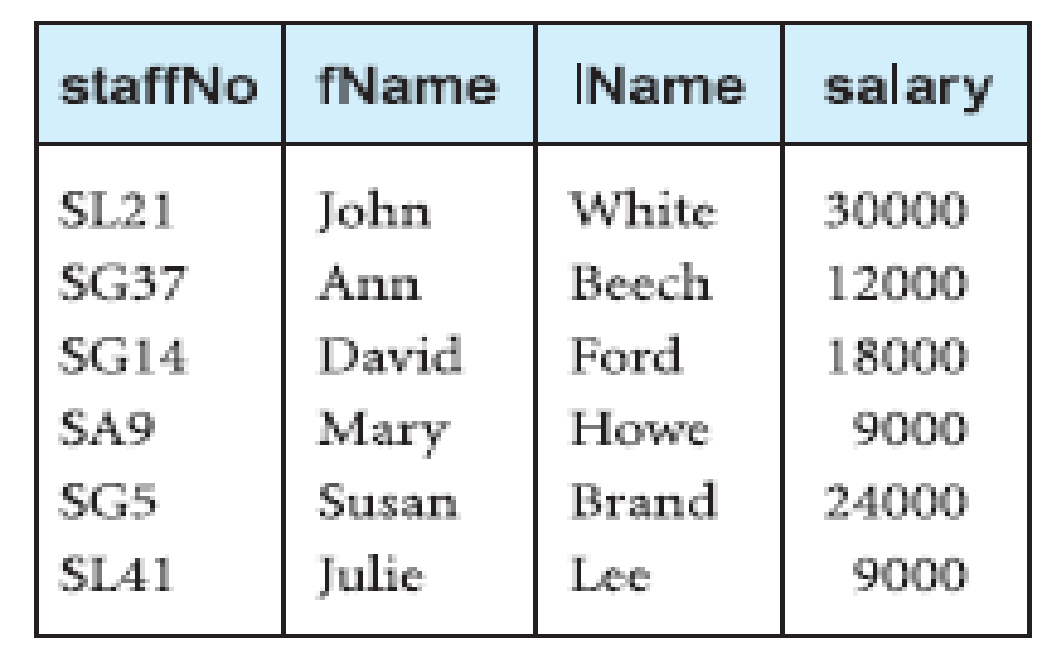
EXAMPLE: PROJECTION
Produce a list of salaries for all staff, showing only staffNo, fName, lName, and salary details.
Π_{staffNo, fName, lName, salary} (Staff)

Slide 15
CARTESIAN PRODUCT
R × S defines a relation that is the concatenation of every tuple of relation R with every tuple of relation S.
R and S do not have to be union compatible.
If relation R has m tuples with i attributes and relation S has n tuples with j attributes, the result is m*n tuples with (i+j ) attributes.

Slide 16
EXAMPLE: CARTESIAN PRODUCT
Student
Course
Reg.# | SName
1 | M. Haseeb Tariq
2 | M. Muneeb Tariq
3 | Mohammad
CCode | CourseTitle
CSC371 | Database Systems I
CSC322 | Operating Systems

Slide 17
EXAMPLE: CARTESIAN PRODUCT
Student X Course
Reg.# | SName
1 | M. Haseeb Tariq
1 | M. Haseeb Tariq
2 | M. Muneeb Tariq
2 | M. Muneeb Tariq
3 | Mohammad
3 | Mohammad
CCode | CourseTitle
CSC371 | Database Systems I
CSC322 | Operating Systems
CSC371 | Database Systems I
CSC322 | Operating Systems
CSC371 | Database Systems I
CSC322 | Operating Systems

Slide 18
EQUI- JOIN
Rows are joined on the basis of values of a common attribute between the two relations.
Rows having the same value in the common attribute are joined.

Slide 19
EQUI-JOIN
Common attributes appears twice in the output
Common attribute with the same name is qualified with the relation name in the output

Slide 20
EXAMPLE: EQUI-JOIN
Faculty
Course
CCode | CourseTitle | FacId
CSC371 | Database Systems I | 1
CSC322 | Operating Systems | 2
CSE305 | Software Requirement Engineering | 1
FacId | FName
1 | Tariq
2 | Zafar
3 | Mohammad
Faculty
Course
_{Faculty.FacId = Course.FacID}

Slide 21
EXAMPLE: EQUI-JOIN
Faculty
Course
_{Faculty.FacId = Course.FacID}
Faculty.FacId | FName
1 | Tariq
1 | Tariq
2 | Zafar
CCode | CourseTitle | Course.FacId
CSC371 | Database Systems I | 1
CSE305 | Software Requirement Engineering | 1
CSC322 | Operating Systems | 2

Slide 22
NATURAL JOIN
Same as equijoin with common column appearing once.
Also called simply the join, most general form of join.

Slide 23
EXAMPLE: NATURAL JOIN
Faculty
Course
FacId | FName
1 | Tariq
2 | Zafar
3 | Mohammad
CCode | CourseTitle | FacId
CSC371 | Database Systems I | 1
CSC322 | Operating Systems | 2
CSE305 | Software Requirement Engineering | 1
Faculty
Course
_{Faculty.FacId = Course.FacID}

Slide 24
EXAMPLE: NATURAL JOIN
Faculty
Course
_{Faculty.FacId = Course.FacID}
FacId | FName
1 | Tariq
1 | Tariq
2 | Zafar
CCode | CourseTitle
CSC371 | Database Systems I
CSE305 | Software Requirement Engineering
CSC322 | Operating Systems

Slide 25
UNION
Union of two relations R and S defines a relation that contains all tuples either in R or S or both, duplicate tuples being eliminated.
Symbolic Notation:
R U S

Slide 26
EXAMPLE: UNION
Course1
CSC371 | BSCS | 4 | Database Systems I
CSC336 | BSCS | 3 | Web Technologies
CSC101 | BSSE | 3 | Introduction to ICT
CSC322 | BSSE | 3 | Operating Systems
Course2
CCode | Program | Cred_Hrs | CourseTitle
CSC322 | BSSE | 3 | Operating Systems
CSC101 | MCS | 3 | Introduction to Computing

Slide 27
EXAMPLE 1: UNION
Course1 U Course2
CSC371 | BSCS | 4 | Database Systems I
CSC336 | BSCS | 3 | Web Technologies
CSC101 | BSSE | 3 | Introduction to ICT
CSC322 | BSSE | 3 | Operating Systems
CSC101 | MCS | 3 | Introduction to Computing

Slide 28
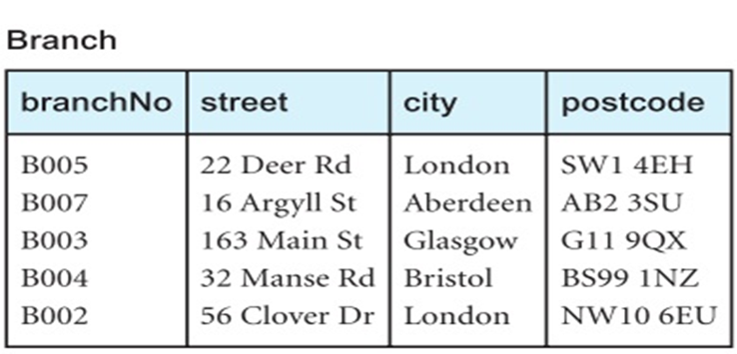
BRANCH RELATION

Slide 29
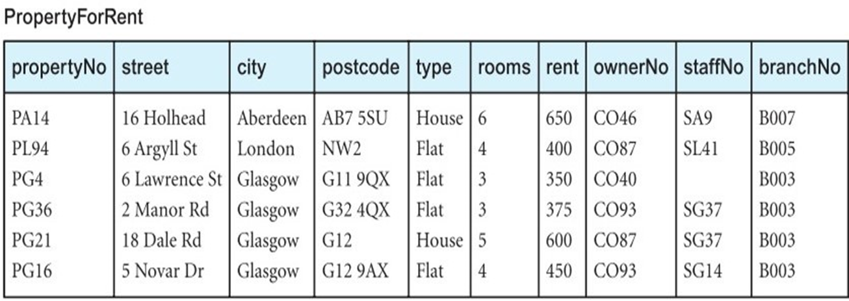
PROPERTY-FOR-RENT RELATION

Slide 30
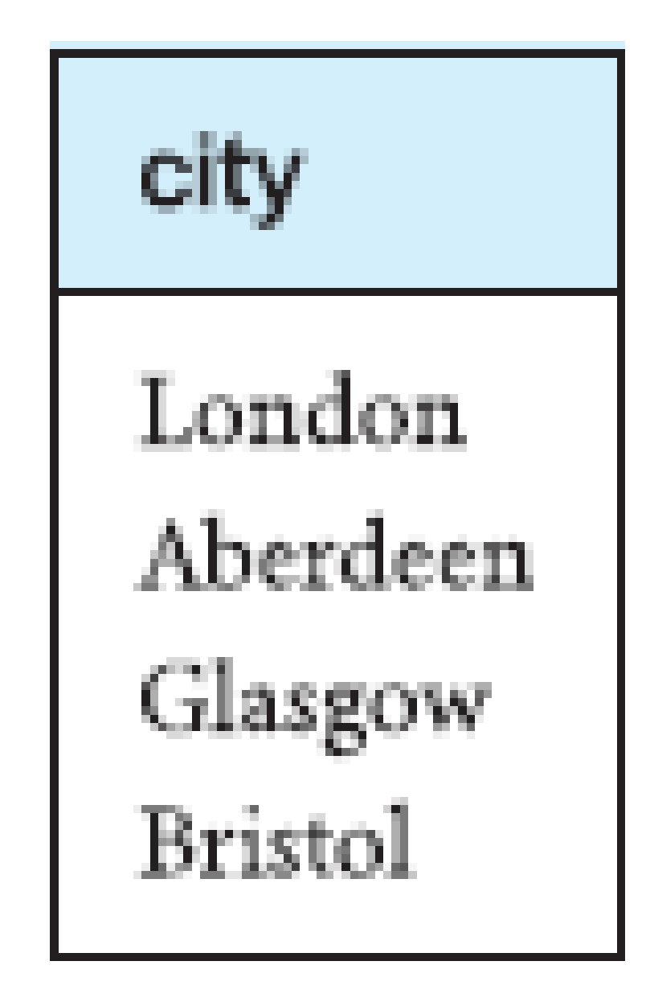
EXAMPLE 2: UNION
List all cities where there is either a branch ofﬁce or a property for rent
Π_{city}(Branch) ∪ Π_{city}(PropertyForRent)

Slide 31
INTERSECTION
Intersection: R ⋂ S is the set of all tuples that are in both R and S
R and S must be union-compatible

Slide 32
EXAMPLE 1: INTERSECTION
Course1 ⋂ Course2
CSC322 | BSSE | 3 | Operating Systems

Slide 33
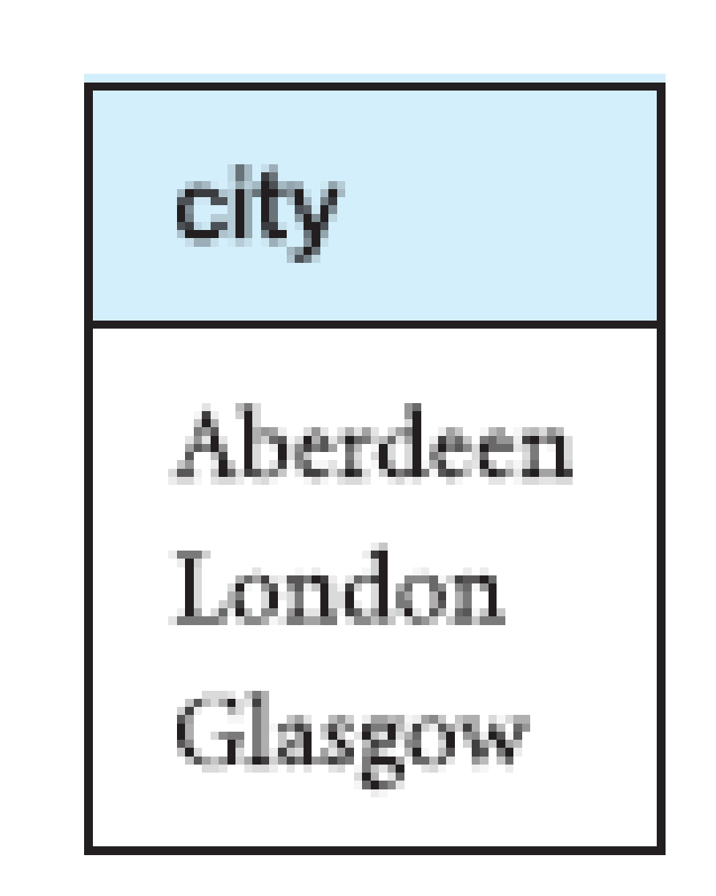
EXAMPLE 2: INTERSECTION
List all cities where there is both a branch office and at least one property for rent
Π_{city}(Branch) ∩ Π_{city}(PropertyForRent)

Slide 34
SET DIFFERENCE
Difference: R – S is the set of tuples that are in R but not in S.
R and S must be union-compatible

Slide 35
EXAMPLE 1: SET DIFFERENCE
Course1 - Course2
CSC371 | BSCS | 4 | Database Systems I
CSC336 | BSCS | 3 | Web Technologies
CSC101 | BSSE | 3 | Introduction to ICT

Slide 36
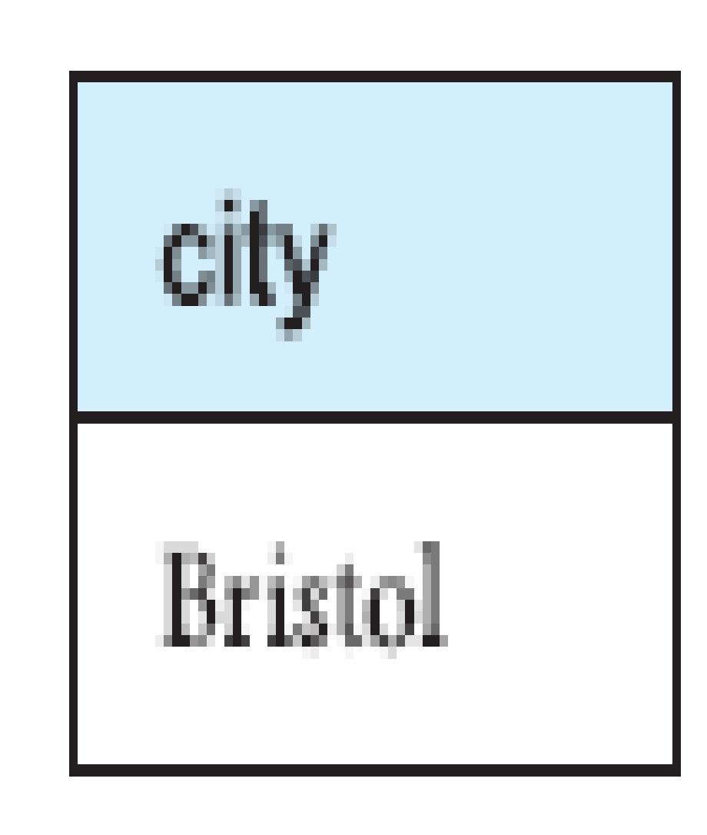
EXAMPLE 2: SET DIFFERENCE
List all cities where there is a branch ofﬁce but no properties for rent
Π_{city}(Branch) - Π_{city}(PropertyForRent)

Slide 37
THETA JOIN
A join that involves a predicate over cartesian product.
Contains tuples satisfying the predicate from the cartesian product.
Here θ can be any condition
R
S
θ

Slide 38
THETA JOIN
Theta join can be rewrite in terms of the Selection and Cartesian product.
= σ_{P} (R × S)
Degree of a Theta join is the same as Cartesian product (sum of the degrees of the operand relations).
R
S
θ

Slide 39
EXAMPLE: THETA JOIN
Student
Course
Reg.# | SName
1 | M. Haseeb Tariq
2 | M. Muneeb Tariq
3 | Mohammad
CCode | CourseTitle
CSC371 | Database Systems I
CSC322 | Operating Systems
σ_{sname=“M. Haseeb Tariq”} (Student X Course)

Slide 40
EXAMPLE: THETA JOIN
Student X Course
Reg.# | SName
1 | M. Haseeb Tariq
1 | M. Haseeb Tariq
2 | M. Muneeb Tariq
2 | M. Muneeb Tariq
3 | Mohammad
3 | Mohammad
CCode | CourseTitle
CSC371 | Database Systems I
CSC322 | Operating Systems
CSC371 | Database Systems I
CSC322 | Operating Systems
CSC371 | Database Systems I
CSC322 | Operating Systems

Slide 41
EXAMPLE: THETA JOIN
σ_{sname=“M. Haseeb Tariq”} (Student X Course)
Reg.# | SName
1 | M. Haseeb Tariq
1 | M. Haseeb Tariq
CCode | CourseTitle
CSC371 | Database Systems I
CSC322 | Operating Systems

Slide 42
EXAMPLE: THETA JOIN
(σ_{sname=“M. Haseeb Tariq”} (Student)) X Course)
Reg.# | SName
1 | M. Haseeb Tariq
1 | M. Haseeb Tariq
CCode | CourseTitle
CSC371 | Database Systems I
CSC322 | Operating Systems

Slide 43
SEMI-JOIN
The semi-join is similar to the natural join and written as R ⋉ S where R and S are relations.
The result of this semi-join is the set of all tuples in R for which there is a tuple in S that is equal on their common attribute names.

Slide 44
SEMI-JOIN
First take the natural join of two tables and then take the projection on the attributes of first table.
Can be rewrite in terms of the Join and Projection operations.
R S = Π_{A} (R S)
Where A is the set of all attributes of R

Slide 45
EXAMPLE: SEMI-JOIN
Faculty
Course
FacId | FName
1 | Tariq
2 | Zafar
3 | Mohammad
CCode | CourseTitle | FacId
CSC371 | Database Systems I | 1
CSC322 | Operating Systems | 2
CSE305 | Software Requirement Engineering | 1

Slide 46
EXAMPLE: SEMI-JOIN
(
Course
)
Π_{FacId,FName}
Faculty
_{Faculty.FacId = Course.FacID}
FacId | FName
1 | Tariq
2 | Zafar

Slide 47
OUTER JOIN
An outer join does not require each record in the two joined tables to have a matching record.
The joined table retains each record - even if no other
matching record exists.

Slide 48
LEFT OUTER JOIN
Contains all tuples of the left table, even if the join condition does not find any matching record in the right table.
Returns all the values from an inner join plus all values in the left table that do not match to the right table, Pad the non-matching tuples with Null (empty).

Slide 49

EXAMPLE: LEFT OUTER JOIN
Faculty
Course
FacId | FName
1 | Tariq
2 | Zafar
3 | Mohammad
CCode | CourseTitle | FacId
CSC371 | Database Systems I | 1
CSC322 | Operating Systems | 2
CSE305 | Software Requirement Engineering | 1
Faculty
Course

Slide 50
EXAMPLE: LEFT OUTER JOIN
Faculty
Course
FacId | FName
1 | Tariq
1 | Tariq
2 | Zafar
3 | Mohammad
CCode | CourseTitle | FacId
CSC371 | Database Systems I | 1
CSE305 | Software Requirement Engineering | 1
CSC322 | Operating Systems | 2
NULL | NULL | NULL

Slide 51
RIGHT OUTER JOIN
Contains all tuples of the right table, even if the join condition does not find any matching record in the left table.
Returns all the values from an inner join plus all values in the right table that do not match to the left table, Pad the non-matching tuples with Null (empty).

Slide 52
EXAMPLE: RIGHT OUTER JOIN
Faculty
Course
FacId | FName
1 | Tariq
2 | Zafar
3 | Mohammad
CCode | CourseTitle | FacId
CSC371 | Database Systems I | 1
CSC322 | Operating Systems | 2
CSE305 | Software Requirement Engineering | 1
CSC471 | Distributed Database Systems

Slide 53

EXAMPLE: RIGHT OUTER JOIN
Faculty
Course
FacId | FName
1 | Tariq
1 | Tariq
2 | Zafar
NULL | NULL
CCode | CourseTitle | FacId
CSC371 | Database Systems I | 1
CSE305 | Software Requirement Engineering | 1
CSC322 | Operating Systems | 2
CSC471 | Distributed Database Systems

Slide 54
FULL OUTER JOIN
Keep all tuples from both relations, padding the non-matching tuples with Null (empty).
The joined table retains each record - even if no other matching record exists.

Slide 55
EXAMPLE: FULL OUTER JOIN
Faculty
Course
FacId | FName
1 | Tariq
2 | Zafar
3 | Mohammad
CCode | CourseTitle | FacId
CSC371 | Database Systems I | 1
CSC322 | Operating Systems | 2
CSE305 | Software Requirement Engineering | 1
CSC471 | Distributed Database Systems

Slide 56

EXAMPLE: FULL OUTER JOIN
Faculty
Course
FacId | FName
1 | Tariq
1 | Tariq
2 | Zafar
3 | Mohammad
NULL | NULL
CCode | CourseTitle | FacId
CSC371 | Database Systems I | 1
CSE305 | Software Requirement Engineering | 1
CSC322 | Operating Systems | 2
NULL | NULL | NULL
CSC471 | Distributed Database Systems

Slide 57
DIVISION
The division is a binary operation that is written as R ÷ S.
The result consists of the restrictions of tuples in R to the attribute names unique to R, for which it holds that all their combinations with tuples in S are present in R.
Notes:
13

Slide 58
DIVISION
Precondition: In R÷ S, the attributes in S must be included in the schema for R. Also, the result has attributes R-S.
SALES(supId, prodId)
PRODUCTS(prodId)
Relations SALES and PRODUCTS must be built using projections.
SALES/PRODUCTS: the ids of the suppliers supplying ALL products.
Notes:
13

Slide 59
EXAMPLE: DIVISION
Completed
Student Task
Fred Database1
Fred Database2
Fred Compiler1
Eugene Database1
Eugene Compiler1
Sarah Database1
Sarah Database2
DBProject
Task
Database1
Database2
Completed ÷ DBProject
Student
Fred
Sarah

Slide 60
THANKS

